Slide 1
NAMED ENTITY RECOGNITION
By Team PERFECT SQUARES
TEAM MEMBERS:
Jai saxena
Pankaj Balchandani
Durgesh Mishra
Niranjan Solanki

Slide 2
CONTENT
NER
Problem statement
Approach
Findings
Result
Conclusion
Future Works

Slide 3

NER
Named entity recognition (NER) sometimes referred to as entity chunking, extraction, or identification is the task of identifying and categorizing key information (entities) in text.
Applications: Human recourses, Content Classification, Customer support, etc.

Slide 4
PROBLEM STATEMENT
Creating a NER model that identifies key tokens and classifies them into set of predefined entities.

Slide 5
DATASET
WISEP data
1753 training examples
63 different types of labels
1366 samples for validation without the NER models
Keys in Dataset
unique_id,
Tokens (Used)
ner_tags(Used)
ner_ids
label_studio_id
Section
bibcode

Slide 6
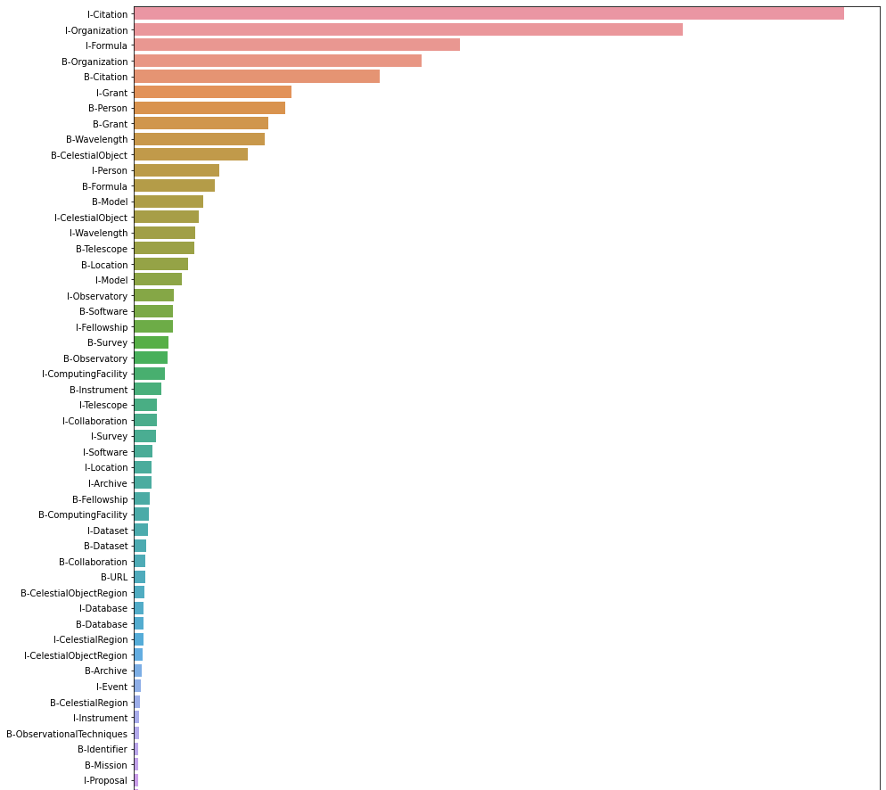

APPROACH
EDA
Preprocessing
Simple RNN (baseline)
LSTM
Bert
Class Distribution

Slide 7
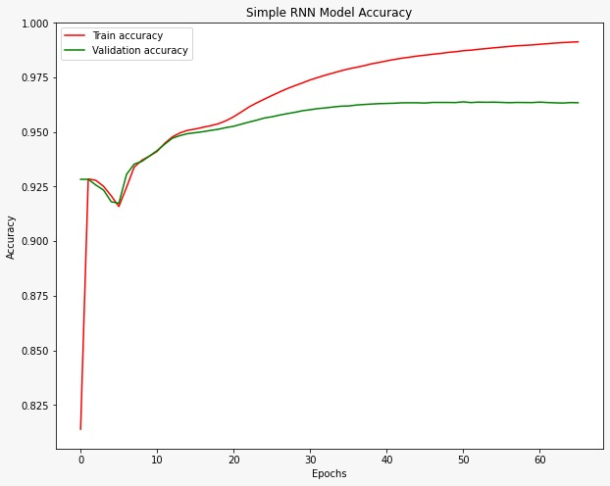
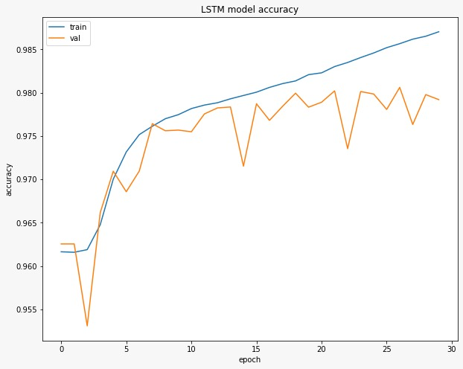

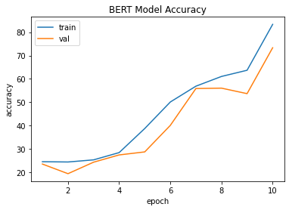
FINDINGS
SIMPLE RNN
LSTM
BERT

Slide 8
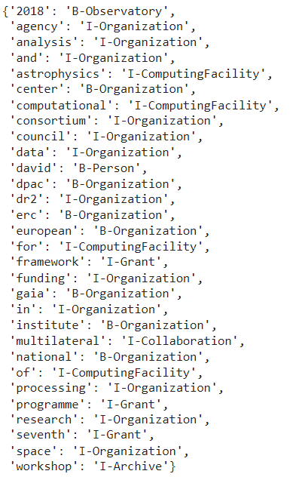
RESULT
Predictions

Slide 9
CONCLUSION
We were able to extract the entities from a sentence and name them with an accuracy as high as
The best model for the NER with the highest accuracy and accurate predictions turned out to be
Model | Accuracy
Simple RNN | 97.6%
LSTM | 97.8%
BERT | 83%

Slide 10
FUTURE WORKS
Use transformer with encoder and decoder to create an NER
Use GPT as decoder unit of transformer
Also perform Hyper Parameter tuning for all the different Models
Work on a larger Dataset and train our models based it.

Slide 11
THANK YOU

